Slide 1
OLTP
Online Transaction Processing
Transaction-oriented Applications
Mostly connected to applications/software, designed towards business needs / logic
Daily Uses
Contains Active Data
May contains some historical data, based on business needs
Usually structured data combined with relational databases and nosql databases

Slide 2
ODS
Operational Data Store
A “merge” area for data coming from different sources
Great place to do data cleansing, reporting and staging
Usually contains active data for a desired period of time (7-60 days)
Data comes in and out by batches (minutes to hours)
Some enterprise solutions would have a separate staging database between ODS and DW.
Usually a somewhat normalized relational structure
structure will be in between OLTP and OLAP

Slide 3
DW/OLAP
Data Warehouse
Contains lots of historical data
Data coming from ODS or Staging in batches, often never deleted
Data used for analytic and reports only
Usually snowflake schema or star schema. Not normalized to save joining time
Fact: typically represent one or a set of business related events
Dimension: supplemental information to facts, add more details to facts
Measure: similar to dimensions, but numerical

Slide 4
Data Lake
Similar to Data Warehouse, lots of Historical data for analytics, data quality is hard to guarantee
Can store structured, semi-structured and unstructured data(basically anything encoded in binary)
little to no constraints on data going in
when poorly managed, could easily turn into a “data swamp”
typically easy to get data into, but hard to get insights out.

Slide 5
Normalization
Improves data integrity -> PK/FK
Decrease storage costs
Increase Join time
1st Normal Form
each cell in the table should contain only atomic values
2nd Normal Form:
every non candidate-key attribute must depend on the whole candidate key, not just part of it
3rd Normal Form:
remove transitive dependency, non-key attributes can not depend on other non-key attributes.

Slide 6
Relational DB Design
Focus on normalization and relationships
Entity Table
represents business entities
book, user, student, courses….
Lookup Table
enumerate/list all potential cases, mostly to supplement entity tables
Joint/junction Table
used to handle many-to-many relationships

Slide 7
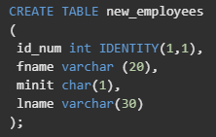
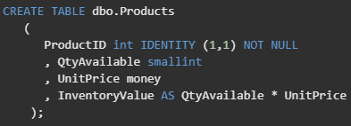
Relational DB Design
Identity Column
seed specifies the starting value
Audit column
status, create date, modified date, created by, modified by
Computed/Derived Column
Computed from other columns, not stored, computed when needed
GUID/UUID
Natural vs Surrogate keys
PII/Sensitive data(data masking)

Slide 8
Data Warehouse Design
focus on star/snowflake and Fact/Dimension
SCD(slowly changing dimensions) - type 2

Slide 9
Performance Monitoring
Locate issue on a server scale
Extended Events
DMV(dynamic management views)
DBCC(Database Console Command)
SQL Server Profiler - performance hit
Locate issue on a workload scale
Tuning Advisor
Execution Plan
https://docs.microsoft.com/en-us/sql/relational-databases/performance/performance-monitoring-and-tuning-tools?view=sql-server-ver15

Slide 10
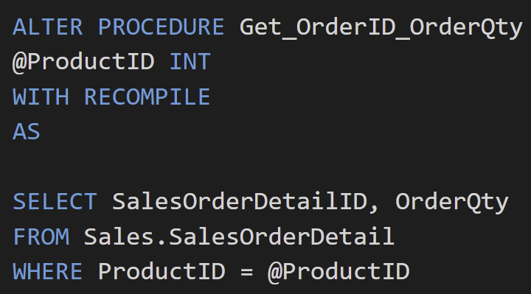
Performance Tuning
Unnecessary group by
reduce the columns in groupby
Correlated subquery
subquery needs to execute for every row of outer query
Join condition vs Where condition
filter data before the join (with join condition)
Temp table, table variable
when data volume is big, consider temp table +index
Be smart with Locks, Isolation Levels
Missing indexes
Bulk insert or massive updating
might block other operations
Recompile of SP, Functions
avoid parameter sniffing related issues

